Slide 1
AP Review Session 3
Q1 & Q2 Preparation

Slide 5
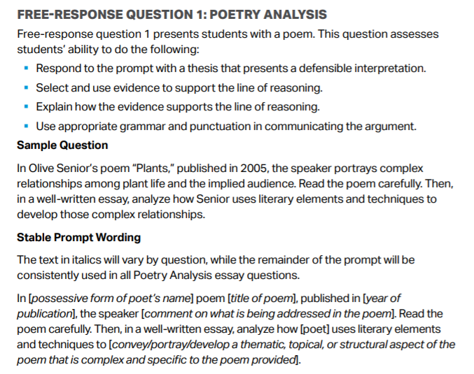
Q1

Slide 6
Q1 What it will look like on EXAM

Slide 7
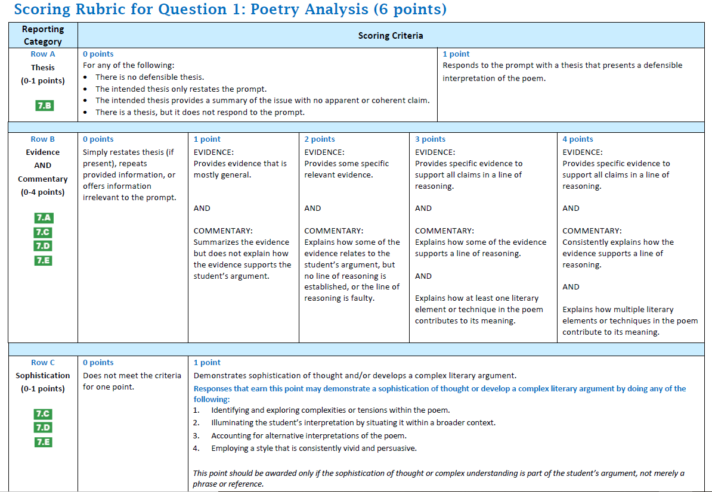

Slide 8
Let’s Get started Q1
Respond to prompt w/thesis, claims, and evidence (10 minutes)
Review sample essay responses w/rubric
Reflect
Notes:
Drop link to Tydings’ weebly with all documents in the chat https://tydings.weebly.com/ap-lit-review.html

Slide 9
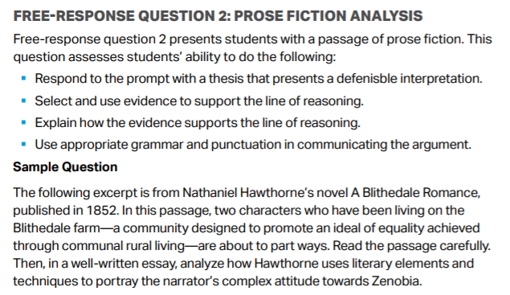
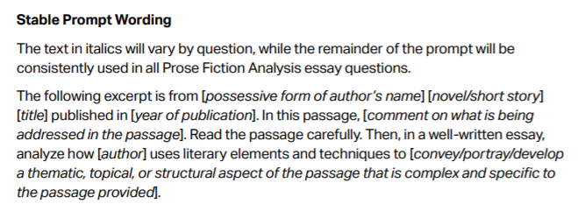
Q2

Slide 10
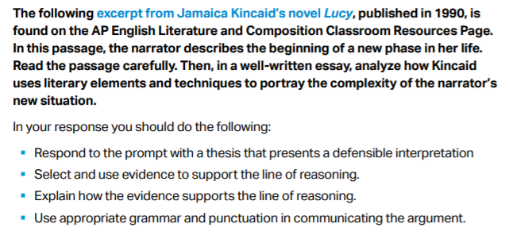
What it will look like on EXAM

Slide 11
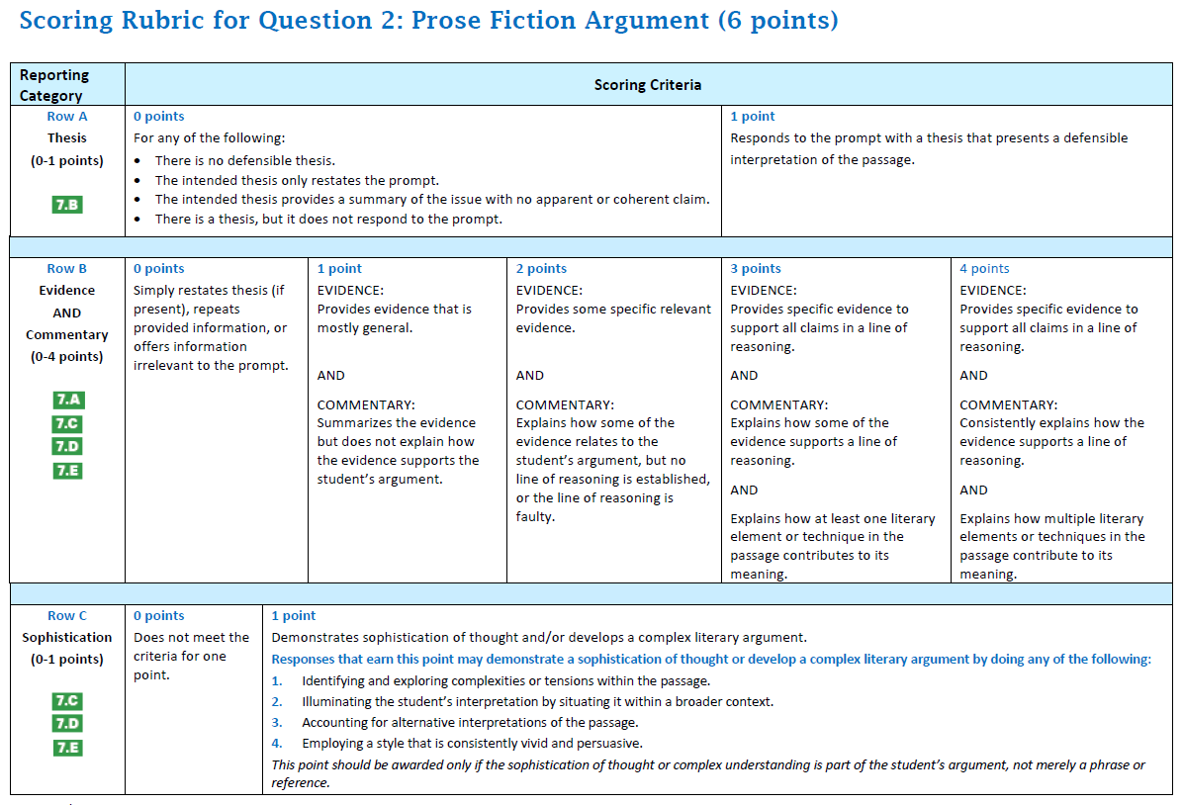

Slide 12
Let’s Get started Q2
Respond to prompt w/thesis, claims, and evidence (10 minutes)
Review sample essay responses w/rubric
Reflect

Slide 13
Tips for Responding to Q1 and Q2
Make a plan
Provides a focus
Thesis, Claims, and Evidence
Then START WRITING ESSAY!
Use paragraphs and claim statements (for each one!)
Remember snippets of evidence!
Write to express not impress. (Avoid using ‘big’ words for the sake of using them!)
Remember adjectives – What kind of diction? What kind of imagery?
Avoid plot summary!

